Slide 1
GTT Foundation’s NES Innovation Awards 2023 Business Plan Template
Project Title : ONLINE VOTING SYSTEM
Project Unique ID :NES2223000051
Name of the College :GOVT. WOMEN’S ENGINEERING COLLEGE AJMER,RAJ

Slide 2
 | Name | Mobile Number | Email Address
Principal/HOD/Dean | Meeta Sharma | 9413059625 | meetasharma@gweca.ac.in
Guide | Parvati Bhurani | 7976216969 | parvatibhurani@gweca.ac.in
Project Leader (Participant1) | Saumya Maheshwari | 9413223768 | 21it21@gweca.ac.in
Participant 2 | Aditee | 8769756859 | 21it01@gwec.ac.in
Participant 3 | Deepshika Verma | 7877732995 | 21it05@gweca.ac.in
Participant 4 | Lakshita Sharma | 7726953386 | 21it11@gweca.ac.in

Slide 3



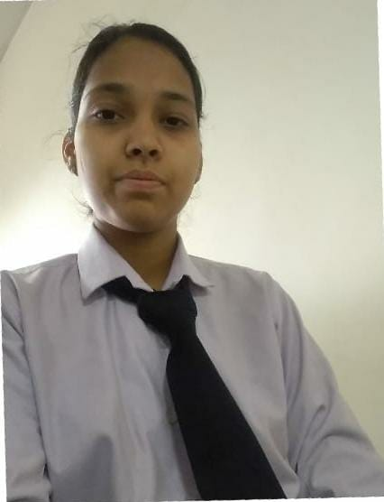

Team Composition
Group photograph with project guide in college uniform as applicable
Project Guide-Parvati Bhurani Team Member-Aditee Team Member-Saumya Maheshwari Team member-Deepshika Verma Team Member-Lakshita Sharma

Slide 4
Slide # 1: What is the Problem
Define the problem/need you are addressing
The current offline system is at least 100 times more unsecure and is regularly hacked. Still we are living with it. It’s a common experience that people go to voting booth to realize that somebody has already voted in their place.
This happens because in the current system voter authentication happens by looking at the face of the voter and matching it with the photograph in the ID. Booth officials generally accept any government ID card as identity proof. People can impersonate anybody else with help of fake ID cards. This can never happen with online voting system.
Also , counting of votes specially in paper ballot happens manually and is prone to clerical errors. Several times recounting has provided different results which proves that errors and manipulation are common.

Slide 5
Slide # 2: What is the solution?
Online Voting is a web-based voting system that will help you manage your elections easily and securely. This voting system can be used for casting votes during the elections held in colleges, etc.
In this system the voter do not have to go to the polling booth to cast their vote. They can use their personal computer to cast their votes.
There is a database which is maintained in which all the name of the voters with their complete information is stored.
Online voting tools and online election voting systems help you make important decisions by gathering the input of your group in a way that’s systematic and verifiable.
Oftentimes, these decisions are made on a yearly basis - during an event (e.g. your organization’s AGM) or at a particular time of the year. Or you might run ongoing polls amongst your group (e.g. anonymous employee feedback surveys).
It’s a good idea to use an online voting system to:
Elect your leadership: A board of directors election is a good example, where there are multiple positions (e.g. chair, vice president, secretary, treasurer). All of which may include supporting documentation (e.g. biographies, resumés, headshots).
Admit new members to your group. This helps you stick to a regular, fair process of evaluation and lets candidates know what to expect.
Gather anonymous feedback from your employees. Managers (and managers of managers) want to know how their employees truly feel about their jobs and work life. Using an online voting system with a capacity for secret balloting helps employees express their true feelings, by understanding and trusting that their feedback will be heard, but not tied directly to them.
Vote on yearly budgets. And since adjustments to your budget are often needed, an online voting system will keep voting secure and accessible - no matter where the members of your group may happen to be.
Alter your operational procedures and bylaws. Just like leadership elections, expect group members to react strongly toward changes - no matter how minor - to organizational processes. You’ll want to collect individual responses to these changes in a systematic manner.
In all of these cases, an online voting system will enable better decisions, justify those decisions, and let you share proof that these decisions were carried out in line with the standards of your group.

Slide 6
Slide # 3: Customer Profile
Customer profile (who is the actual user / customer for your product? Describe the customer's profile clearly)
Educational institutions - Across colleges, universities, and K-12 schools, votes and elections for faculty, student, and alumni groups are built into their foundations. The wider school systems themselves often have their own large-scale matters to vote on as well. Example educational institution voting events include SGA elections, faculty elections, and alumni elections.

Slide 7
Slide # 4: Differentiation / Innovation
Differentiation / Innovation (What makes your product or solution approach different from what others have tried out?)
Online Voting is a web-based voting system that will help you manage your elections easily and securely. This voting system can be used for casting votes during the elections held in colleges, etc.
In this system the voter do not have to go to the polling booth to cast their vote. They can use their personal computer to cast their votes. There is a database which is maintained in which all the name of the voters with their complete information is stored.

Slide 8
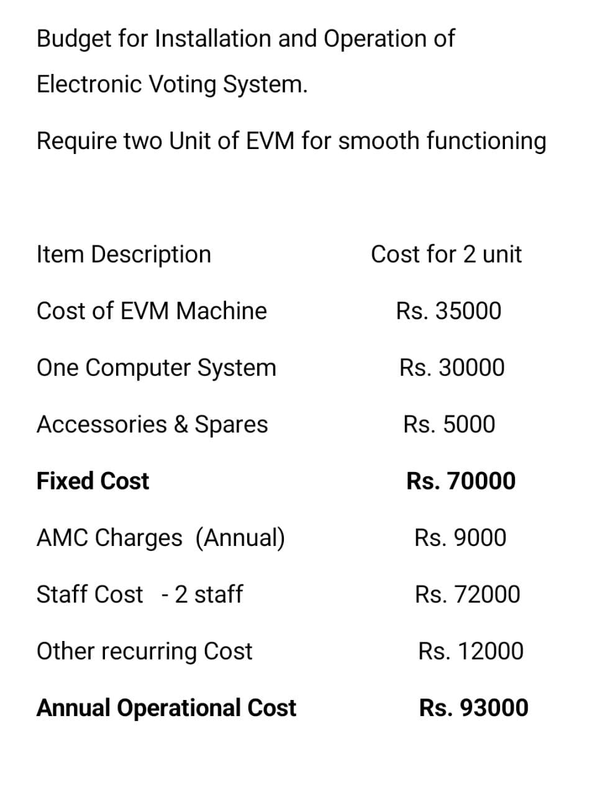
Slide # 5: Budget
Budget (how much time and cost is involved to build the final product?)

Slide 9
Video of Prototype or Application
Share a video demonstration of your idea/project
Share it via mail/zip/Google Drive link
Time Limit maximum 1 minutes

Slide 10
Thank You

